Slide 1

BREAST CANCER CLASSIFICATION AND LOCATION DETECTION USING DEEP LEARNING METHODS
PRESENTED BY:
NAVEENKUMAR S - RA1911029010014
S. AKANSHA - RA1911029010060
GUIDE NAME : Dr. L. ANAND
Batch ID: NW108

Slide 2

TABLE OF CONTENTS
01
02
03
04
05
06
07
08
09
10
ABSTRACT
REQUIREMENTS
INTRODUCTION
ARCHITECTURE DIAGRAM
LITERATURE REVIEW
IMPLEMENTATION
EXISTING AND PROPOSED METHODOLOGY
PERFORMANCE EVALUATION
PROBLEM IDENTIFICATION AND DESCRIPTION
RESULTS AND ANALYSIS

Slide 3


ABSTRACT
Breast cancer mortality can be decreased by effective early cancer detection, as it is the second leading cause of death in women. Early detection and classification of breast cancer can provide the best possible treatment. There has been a lot of research done on the topic of breast cancer. The most common technique used in research is machine learning. A lot of previous research has been done using machine learning and deep learning. Algorithms like decision tree, KNN, SVM, naïve base, etc. give much better results in their field. But today, a newly developed technique is used to classify breast cancer. Deep learning is used to overcome the issues of machine learning.
In this study, three datasets are used: ultrasound images, histopathological images, and mammography images. We utilize these images to determine whether or not a person has breast cancer and if he/she has cancer, we detect the location of cancer. This study suggested and improved Mask R-CNN segments, a popular deep learning instance segmentation method that detects objects at the pixel level. It combines an object recognition task, in which the goal is to identify the class of an item, with image bounding box prediction and a semantic segmentation task, in which each pixel is assigned to one of many predetermined categories.
Therefore, we use an R-CNN mask and a Patch detection algorithm, which has the advantage of automatic image segmentation - determining the tumor interface, drawing the contours of the tumor region before classifying the lesions between benign and malignant. We used several deep learning algorithms to classify and predict whether a person has breast cancer or not.

Slide 4

INTRODUCTION
Breast cancer, the second most prevalent cause of mortality for women, is a common tumor that frequently affects females. Breast cancer has become increasingly common worldwide over time, and each year, more instances are reported. Early detection increases the likelihood of effective treatment and survival, but its diagnosis takes time and usually necessitates consensus amongst pathologists.
Breast cancer, the second most prevalent cause of mortality for women, is a common tumor that frequently affects females. Breast cancer has become increasingly common worldwide over time, and each year, more instances are reported. Early detection increases the likelihood of effective treatment and survival, but its diagnosis takes time and usually necessitates consensus amongst pathologists. Systems for computer-aided diagnosis (CAD) can increase the precision of diagnoses. There are two types of breast cancer: benign (not dangerous) and malignant (threatening). The prognosis for breast cancer depends heavily on the early discovery of tumors and the ability to differentiate between benign images and malignant images.
Detection of breast cancer in its early stages using image processing techniques includes four parts. In the first part the digital images (mammographies) are pre-processed to remove any kind of noise. Then in the second part the images undergo the segmentation process to enhance the tumor part. After this, in the third part, the important features in the segmented images are extracted. Finally, in the fourth part, with the help of the extracted features, the images are classified into normal, benign or malignant. Here, ‘normal’ represents the breast with no tumor, ‘benign’ represents the breast with non-cancerous tumor and ‘malignant’ represents breast with cancerous tumor.

Slide 5

INTRODUCTION
Mammography is a highly well-liked and commonly utilised breast cancer screening approach since it is the only imaging modality that has been shown to significantly lower breast cancer mortality. In this study, we also classified breast cancer using mammography, ultrasound, and histopathology images. Clinicians have utilized CAD systems to help them interpret medical imaging to better diagnose illness and its crucial function is feature extraction. Since they are rigid, traditional feature extraction methods have drawbacks.
In the present-day scenario, to observe breast cancer mammograms are used and they are known to be the most effective scanning technique. In this paper the detection of cancer cells is done by machine learning technique.
A method of improving a picture or extracting important information from it involves converting an image into a digital format and performing operations on it. An image is used as the input and features or qualities of the picture may be output in this sort of signal processing. An image processing system typically treats pictures as two-dimensional signals and processes them using specified signal processing techniques.
The following are the top three image processing techniques:
Import a picture using digital or optical scanning.
Picture analysis and processing, including data compression, picture magnification, and looking for patterns in images that are imperceptible to the human eye, such as satellite photographs.
The final stage, output, is when the outcome may be altered using a report based on a picture or image analysis.

Slide 6

INTRODUCTION
For classification, we have used Convolutional Neural Network along with DenseNet 169, DenseNet 121, ResNet 101 in our model. Comparison is done between DenseNet and ResNet 101.
After the classification is done, to identify distinct items in a picture and create a bounding box around a particular object, techniques called object detection and segmentation are used.
Such techniques for object recognition and segmentation are Mask R-CNN and patch detection.
Mask R-CNN has the ability to construct a bounding box for the target object as well as further mark and categorize whether the pixels in the bounding box belong to the item or not, allowing for the identification of the object, marking of the object's border, and detection of critical spots.
Patch detection is a method to detect metastatic cancer in tiny image patches acquired from bigger digital pathology images. Patch detection provides binary target visualisation per tissue slice.

Slide 7

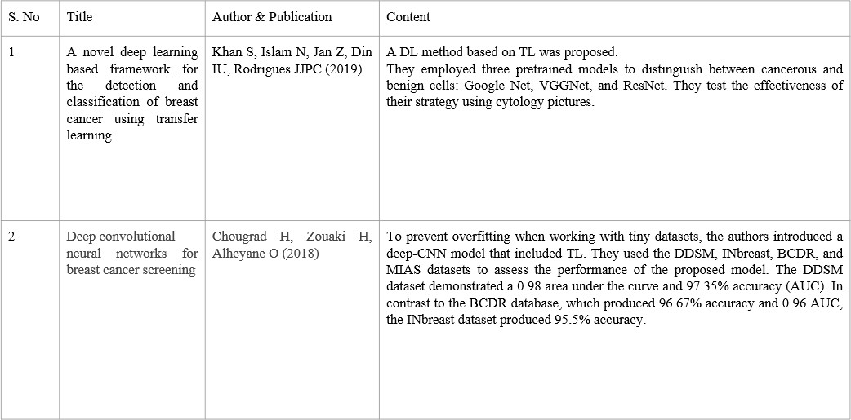
LITERATURE REVIEW

Slide 8

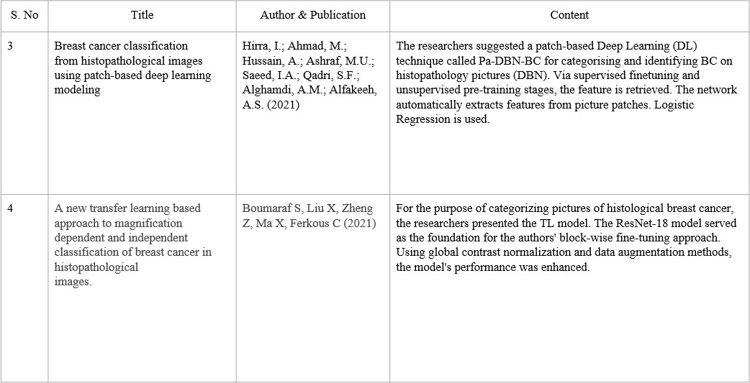
LITERATURE REVIEW

Slide 9

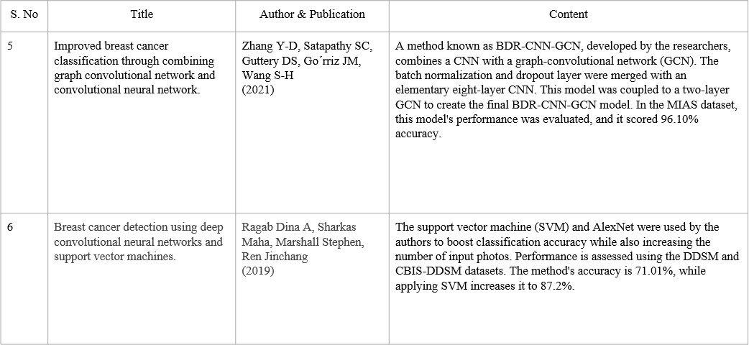
LITERATURE REVIEW

Slide 10

EXISTING AND PROPOSED METHODOLOGY
One in eight breast cancers are missed by screening mammography. Breast density increases the chance of obtaining incorrectly negative findings in women. False-negative mammograms can make women feel insecure when they actually have breast cancer because they mislead them.
Despite the success CNN architectures have had in diagnosing breast cancer, there are still too many hyperparameters, which makes it difficult to get improved results.
Additionally, the existing system merely categorized the inputs as positive or negative. The presence of the tumor has not been determined in what part of the body.
The proposed method is by detecting and locating the cancer. This is done by Mask R-CNN, which has the ability to construct a bounding box for the target object as well as further mark and categorize whether the pixels in the bounding box belong to the item or not, allowing for the identification of the object, marking of the object's border, and detection of critical spots.
Patch detection is also method used to detect metastatic cancer in tiny image patches acquired from bigger digital pathology images. Patch detection provides binary target visualisation per tissue slice.

Slide 11

PROBLEM IDENTIFICATION AND DESCRIPTION
More than 2 million new cases are reported each year, and in 2018, the illness was responsible for 11.6% of all cancer cases and 24.2% of cases in women, making it the most common cancer globally and the top cause of death (6.6%) for women.
Early breast cancer identification should take into account two distinct clinical situations, similar to any other primarily chronic condition. The diagnosis is either the result of an early inquiry of a patient's complaint or a physical exam finding, or it is established by a screening test that detects the illness in an asymptomatic patient before it creates symptoms.
The major way for detecting breast cancer early is X-ray mammography. Although mammography is an excellent screening technique, it does not offer certain and accurate findings for women with thick breasts or those undergoing surgical operations. Recent studies have revealed that MRI is a superior option to mammography because it does not entail any radiation exposure. The following are the primary disadvantages of breast MRI: The specificity is too poor, and the interpretation is difficult and non-standardized, thus only high-risk women should be screened.

Slide 12
REQUIREMENTS
COMPONENTS:
To produce the specification for the software requirements, the analytical work has been completed. By creating an information description as a representation of system behaviour, a demonstration of performance objectives and design boundaries, and appropriate validation criteria, the purpose and performance supplied to software as part of system engineering are enhanced.
REQUIREMENTS FOR HARDWARE:
Processor : Intel Core Duo 2.0 GHz or higher
Hard Disk : Minimum 1 GB and Greater
RAM : 18 GB
REQUIREMENTS FOR SOFTWARE:
Operating system : Windows 11
IDE : Google Colaboratory, Jupyter
PROJECT OVERVIEW:
Coding Language : Python

Slide 13

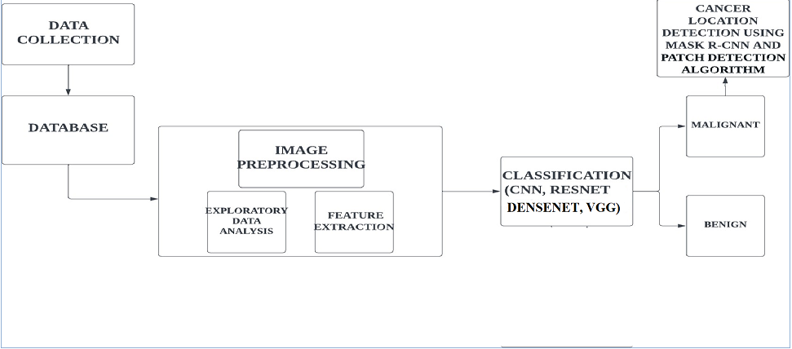
ARCHITECTURE DIAGRAM

Slide 14
IMPLEMENTATION
In this project, we have used three different datasets:
ULTRASOUND:
Sound waves are used during a technique known as a breast ultrasound to see within your breasts. It may be used by your healthcare provider to detect breast problems. It also allows your physician to evaluate how effectively the blood is reaching certain areas of your breasts. This test is usually done when a change has been noted on a mammogram or when a change is felt but not evident on an ultrasound.
We use several classification algorithms such as CNN, ResNet, VGG, and DenseNets to first classify the input images as Malignant or Benign. The achieved results are discussed in the Results sections. Once the Images are classified , we then use the MASK-RCNN algorithm to detect the location of the cancer.
Breast ultrasound pictures from women aged 25 to 75 comprise the baseline data. This information was gathered in 2018. There are 600 female patients in all. There are 780 photos in the collection, with an average size of 500 by 500 pixels. The photos are made up of PNG files. The images taken in the real world are shown alongside the originals. The photographs are divided into three categories: benign, malignant, and normal.

Slide 15
IMPLEMENTATION
2. HISTOPATHOLOGY:
Histopathology pictures are obtained by a procedure known as a biopsy. After the photos are acquired, data augmentation is done. The deep learning community has recently paid a lot of attention to data augmentation. Neural networks need a lot of training data to function well, however the data sets currently accessible in the medical sector are from low-resource regions.
Therefore, to increase the variety of the fundamental dataset, a data augmentation approach must be applied. After that, the CNN Algorithm is trained to determine whether or not a picture includes cancer. After classification, we use the Patch Detection Algorithm to find the cancer cell.
There were 277524 total photographs, 198738 images of people without cancer, 78786 images of persons with cancer. 162 whole mount slide pictures of Breast Cancer (BCa) specimens that had been scanned at 40x made up the original dataset. 277,524 patches of size 50 50 were produced, of which 128 738 IDC negative patches and 78,786 IDC positive patches were retrieved.

Slide 16
IMPLEMENTATION
3. MAMMOGRAPHY:
The patient's breast is first placed on a flat plate during a mammography, and a parallel plate is used to compress it. A short burst of radiation from the x-ray machine travels through the breast and is picked up on the other side. In contrast to a photographic film plate, which captures the x-ray image on film, a solid-state detector may be able to produce digital images by delivering electrical signals to a computer. Mammograms are the medical word for the images.
Dense tissue sections, such as connective and glandular tissue or tumours, appear whiter on a grey background on a film mammography, whereas low density tissues, such as fat, seem translucent (i.e., darker shades of grey).
The Digital Database for Screening Mammography (DDSM) has been revised and standardised as the CBIS-DDSM (Curated Breast Imaging Subset of DDSM) [8]. 2,620 digitalized film mammography studies may be found in the DDSM database. It includes illustrations of healthy, malignant, and benign disorders with validated pathology data. Because of the scale of the database and the ground truth verification, the DDSM is a useful tool in the design and testing of decision support systems.

Slide 17

PERFORMANCE AND EVALUATION
We employed deep learning algorithms to categorise breast cancer pictures as malignant or benign in this study. We made use of ultrasound images, histopathological images, and mammography images. After predicting the malignancy, we apply location detection techniques to pinpoint its exact site. To assess performance, a range of matrices such as accuracy, precision, sensitivity, and specificity were employed.
DenseNet 169 was determined to be the most accurate and effective classifier on the ultrasound pictures dataset, with average accuracies ranging from 94.00% to 100% for binary and multi-class classification. The MASK R-CNN Algorithm is then used to find the malignant tumour. We used the CNN model to categorise the input on the histopathology picture dataset, and then we used the Patch detection approach to indicate the location of the cancer.
In this case, multiclass classification was used to determine the patient's stage of cancer. We tested multiple deep learning models on the mammography picture dataset, with the VGG model outperforming the others. We categorised the input using that, and then the patch detection technique was applied.
Additionally, we plan to broaden our framework to enable it to handle more complicated datasets in order to diagnose breast cancer photos using a single application

Slide 18

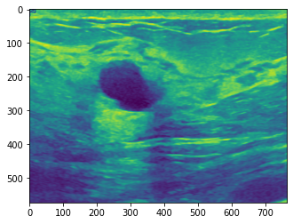
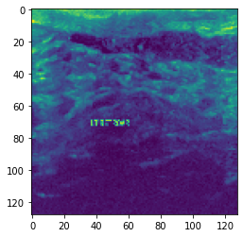
RESULTS AND ANALYSIS
INTRODUCTION:
In this chapter, the practical outcomes that were acquired while the project was being put into action are discussed.
ULTRASOUND:
Using the Ultrasound Dataset, we first perform some Image preprocessing techniques to resize and correct the images.
ORIGINAL IMAGE VS RESIZED IMAGE

Slide 19
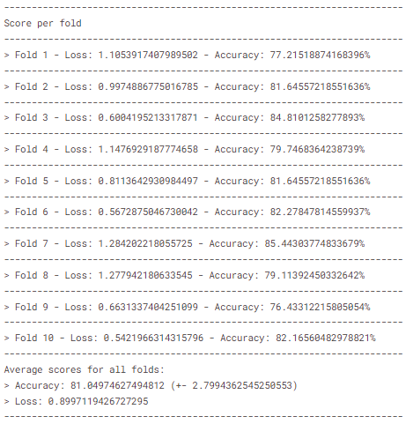
RESULTS AND ANALYSIS
a) CNN USING K-FOLD CROSS VALIDATION:
A CNN is created by carefully stacking a number of these layers. Here, we define a high-level CNN to determine the output classification probabilities after applying a convolution layer, an activation layer, a fully connected layer, and a convolution layer to an input to acquire the classification probabilities. Adam Optimizer and Relu were used as the activation function. We apply the K-Fold cross validation approach after the CNN Layers are defined. The procedure has a single parameter, k, which specifies how many groups should be formed from a given data sample. As a result, the procedure is commonly known as k-fold cross-validation. When a specific k value is chosen, it may be substituted for k in the model's reference, as when k = 10 was used to represent 10-fold cross-validation. The Result Obtained is shown in the Figure below:
RESULT OF CNN USING K-FOLD USING CROSS VALIDATION
As we can see, the average accuracy attained is 91.04%, while the average loss is 0.899.

Slide 20
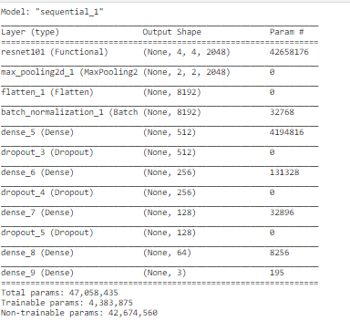
RESULTS AND ANALYSIS
b) RESNET 101:
Here we define a Resnet101 model. The defined model is shown in the image below:
RESNET 101
By training our dataset in the defined model we get the following results:
Train accuracy = 0.9798657894134521
Validation accuracy = 0.8656716346740723
Test accuracy = 0.8888888955116272
f1_measure = 0.8893466348937087
KAPPA = 0.8100412139378044
roc_area = 0.9742590133570231

Slide 21
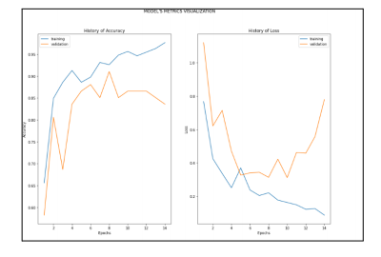
RESULTS AND ANALYSIS
b) RESNET 101:
VISUALIZATION OF RESNET 101

Slide 22
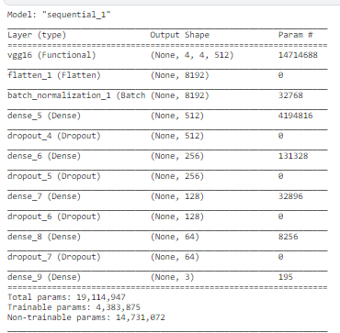
RESULTS AND ANALYSIS
c) VGG 16:
The VGG 16 model is defined as shown in the image below:
VGG 16
By training our dataset in the defined model we get the following results:
Train accuracy = 0.986577153205871
Validation accuracy = 0.9552238583564758
Test accuracy = 0.9743589758872986
f1_measure = 0.9744646080523943
KAPPA = 0.9561633570625703
roc_area = 0.9957788020980289

Slide 23
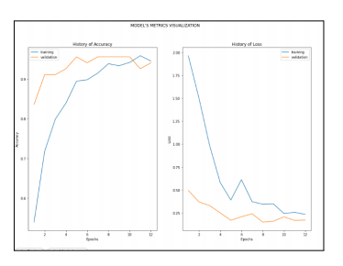
RESULTS AND ANALYSIS
c) VGG 16:
VISUALIZATION OF VGG 16

Slide 24
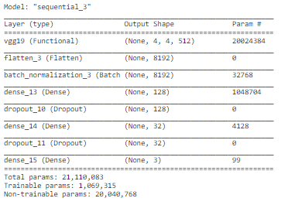
RESULTS AND ANALYSIS
d) VGG 19:
The VGG 19 model is defined as shown in the image below:
VGG 19
By training our dataset in the defined model we get the following results:
Train accuracy = 0.9882550239562988
Validation accuracy = 0.9402984976768494
Test accuracy = 0.9658119678497314
f1_measure = 0.9660831689677843
KAPPA = 0.941805521014673
roc_area = 0.9984315746197393

Slide 25
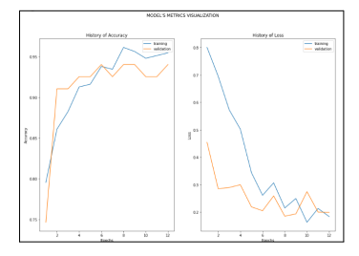
RESULTS AND ANALYSIS
d) VGG 19:
VISUALIZATION OF VGG 19

Slide 26
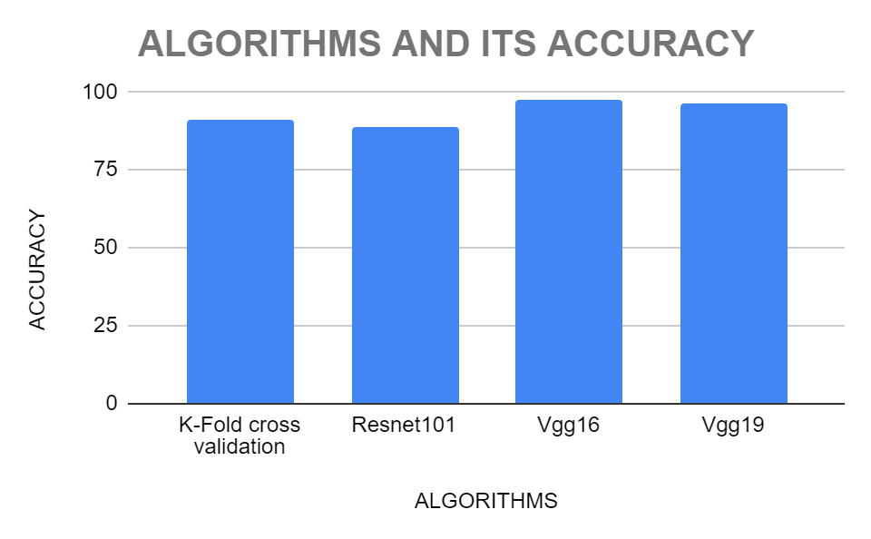
RESULTS AND ANALYSIS
COMPARISON OF ALGORITHMS:

Slide 27
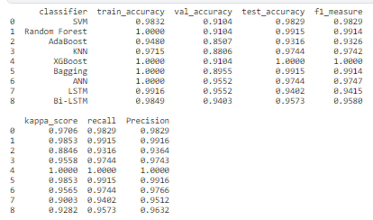
RESULTS AND ANALYSIS
e) DENSENET 121:
Using Transfer learning, we have used Dense 121 after training the images on the algorithms like SVM, Random Forest, AdaBoost, KNN, XGBoost, Bagging, ANN, LSTM and Bi-LSTM. The Results obtained are shown in the image below:
DENSENET121

Slide 28
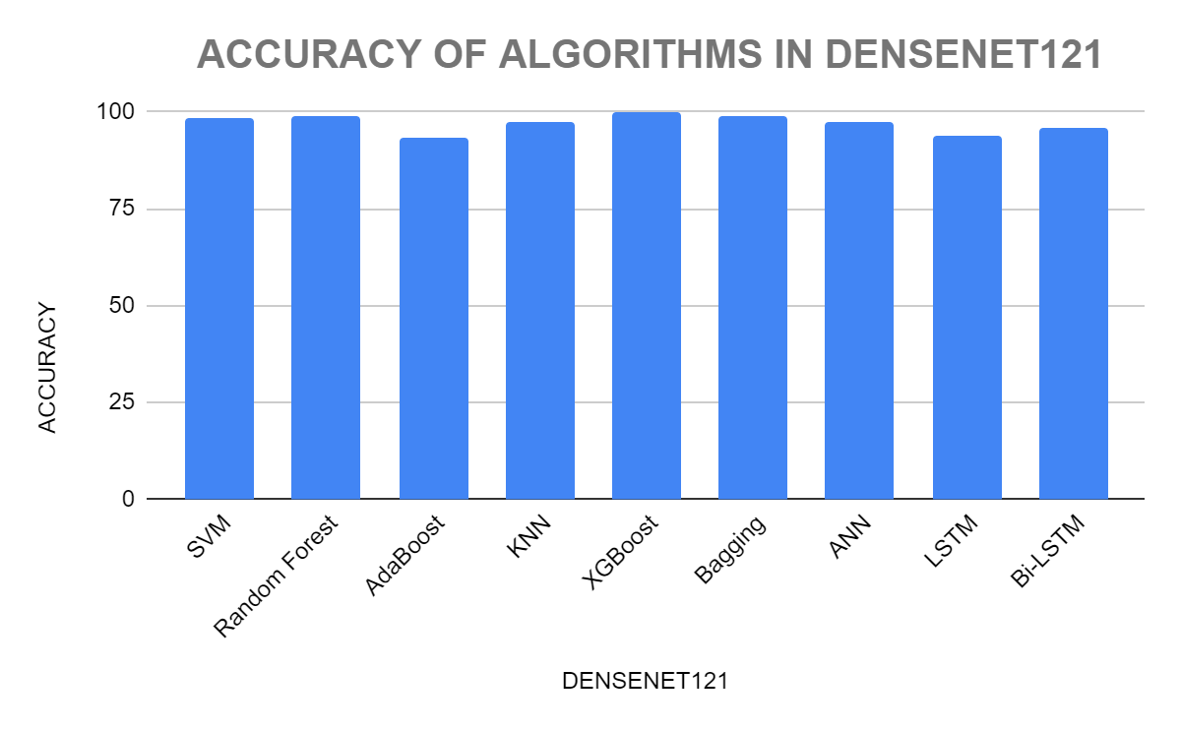
RESULTS AND ANALYSIS
COMPARISON OF DENSENET 121 ALGORITHMS:

Slide 29
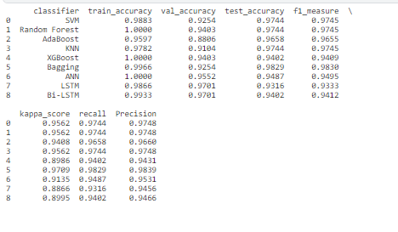
RESULTS AND ANALYSIS
f) DENSENET 169:
Using Transfer learning, we have used Dense 121 after training the images on the algorithms like SVM, Random Forest, AdaBoost, KNN, XGBoost, Bagging, ANN, LSTM and Bi-LSTM. The Results obtained are shown in the image below:
DENSENET169

Slide 30
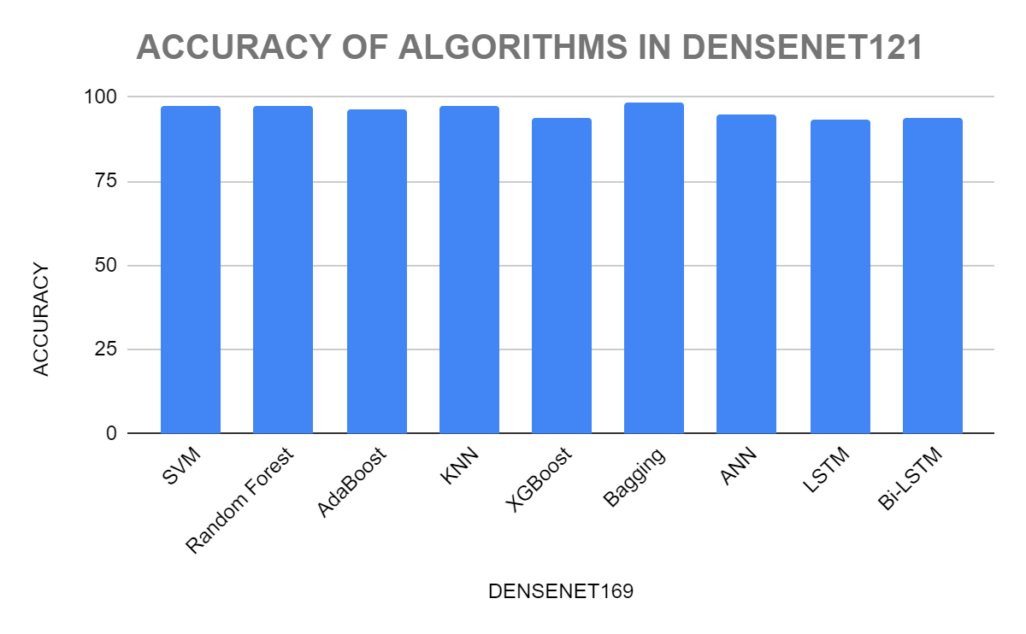
RESULTS AND ANALYSIS
COMPARISON OF DENSENET 169 ALGORITHMS:

Slide 31
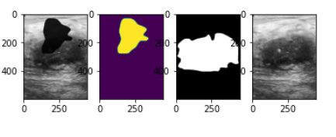
RESULTS AND ANALYSIS
We can plainly observe from the algorithms utilized that DenseNet Models have outperformed all other deep learning models.
We employ the MASK - RCNN algorithm to locate the tumor once the images have been classified as malignant or benign. So we install the model and import the MASK RCNN Model from torch. We train the model for 35 epochs and the results obtained are shown below:
MASK R-CNN
The figure above shows that the patches are masked. In order to identify the malignant tumor, we next use the predicted output to draw a square over the mask.

Slide 32
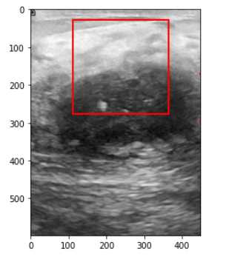
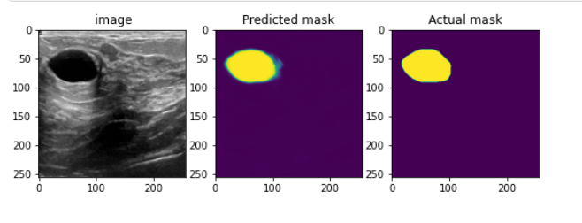
RESULTS AND ANALYSIS
MARKED PATCHES
We can see the comparison between the actual mask and the predicted mask from the image below:
ACTUAL VS PREDICTED MASK

Slide 33
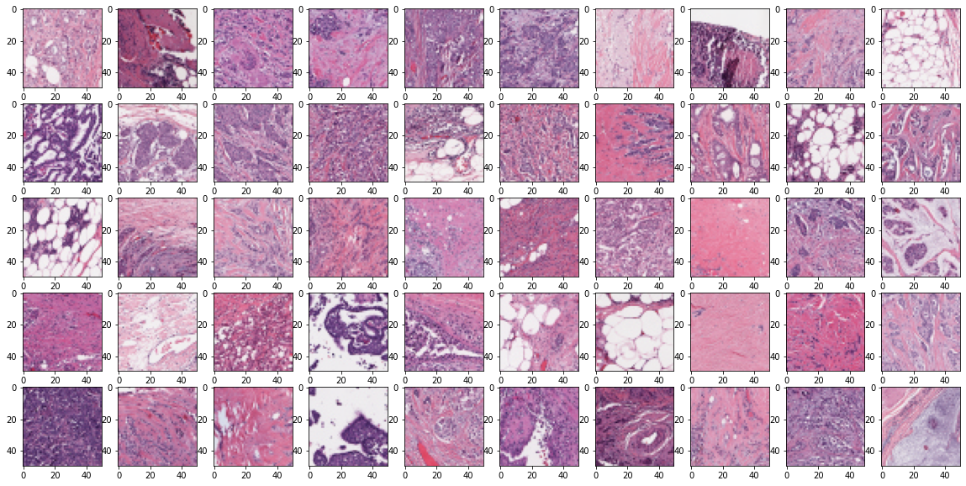
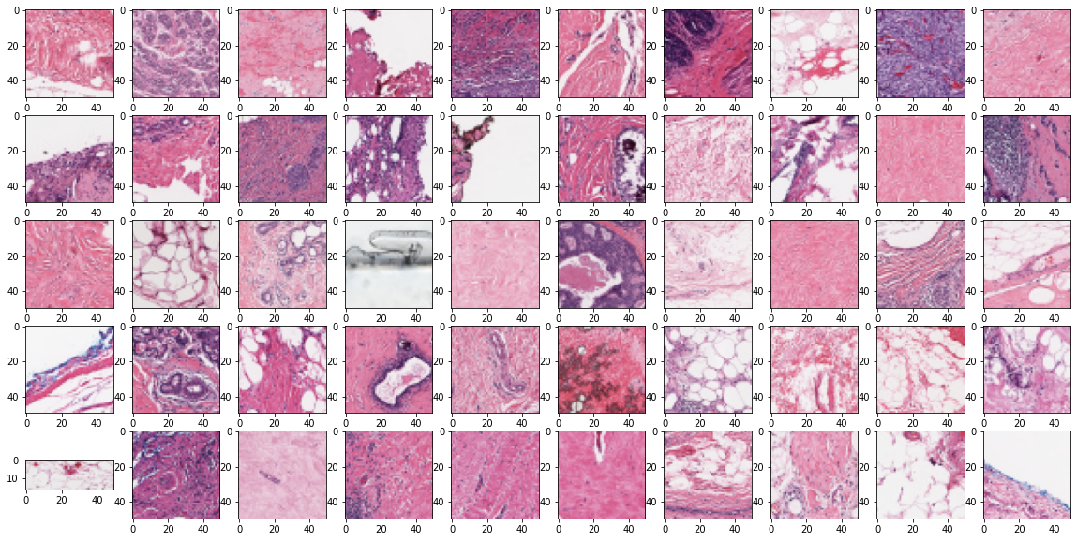
RESULTS AND ANALYSIS
2. HISTOPATHOLOGY:
We use the Histopathology images dataset as shown below:
HISTOPATHOLOGY DATASET IMAGES OF CANCER PATCHES HISTOPATHOLOGY DATASET IMAGES OF HEALTHY PATCHES
Using this model we obtain an accuracy of 94.86%.

Slide 34
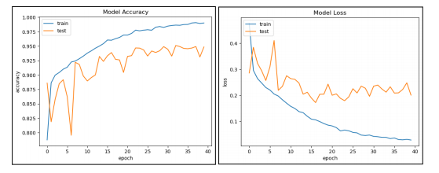
RESULTS AND ANALYSIS
VISUALIZATION OF HISTOPATHOLOGY ACCURACY

Slide 35
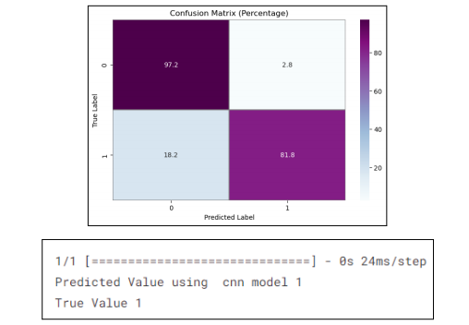
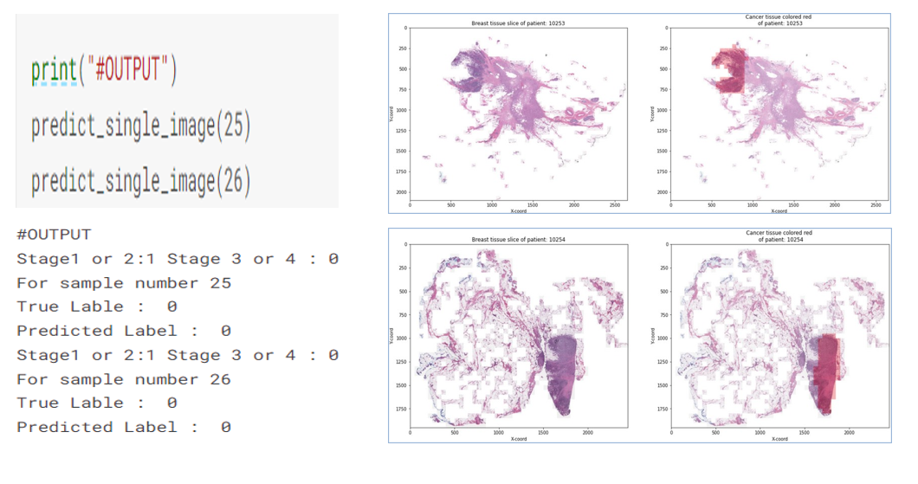
RESULTS AND ANALYSIS
Finally, a Patch detection method is used to locate the cancer.
CONFUSION MATRIX RESULT OF CANCER LOCATED USING PATCH DETECTION

Slide 36
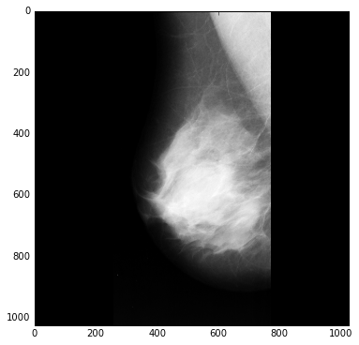
RESULTS AND ANALYSIS
3. MAMMOGRAPHY:
First we load the dataset to perform some analysis.
MAMMOGRAPHY DATASET

Slide 37
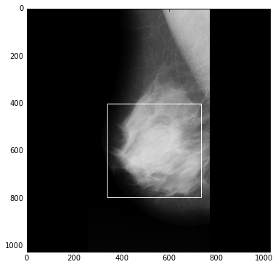
RESULTS AND ANALYSIS
From the image we see the Region of Interest (ROI) by drawing a box around it.
REGION OF INTEREST (ROI)

Slide 38
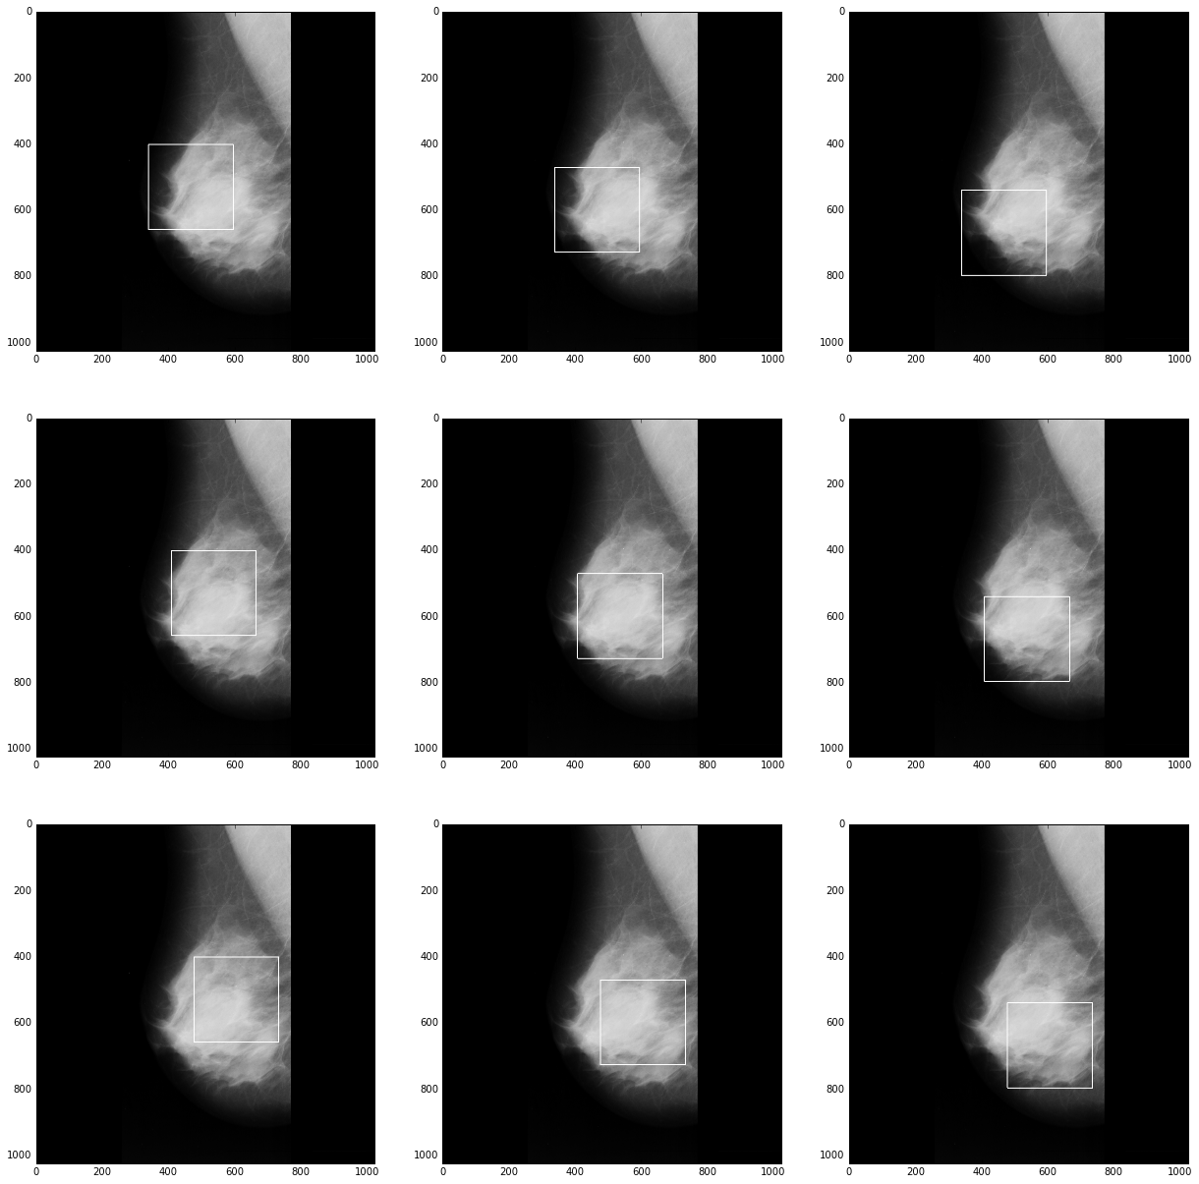
RESULTS AND ANALYSIS
We show the 9 patch image for the large ROI (Region of Interest).
PATCH IMAGES FOR ROI

Slide 39
RESULTS AND ANALYSIS
Then we use find contours for the image segmentation.
CONTOURS FOR IMAGE SEGMENTATION

Slide 40
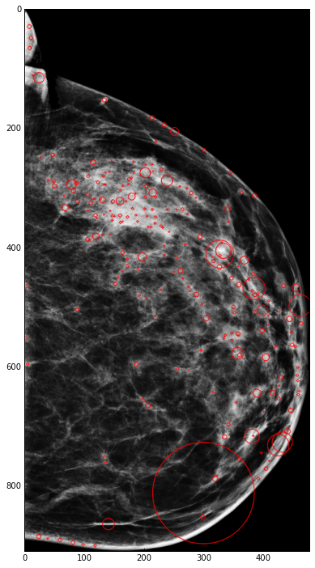
RESULTS AND ANALYSIS
We use Blob detection to find the candidate's Region of interest.
BLOB DETECTION FOR ROI

Slide 41
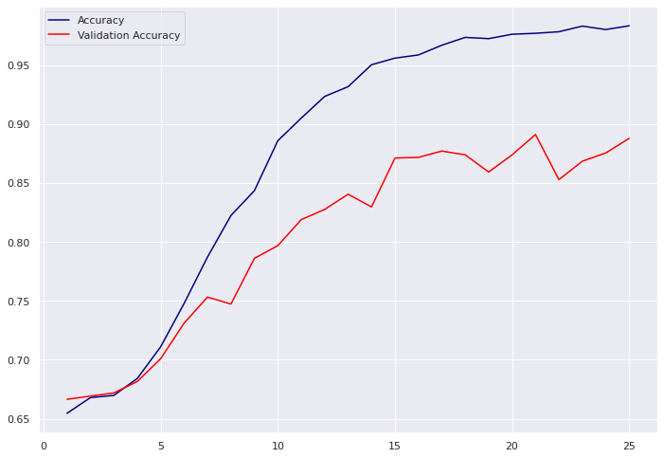
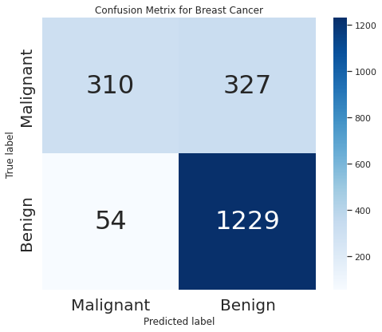
RESULTS AND ANALYSIS
Then a convolutional neural network (CNN) is used to categorise microcalcifications and masses in a mammogram as benign or malignant. A mammography is categorised as normal if there are no masses in the breast tissue.
VISUALIZATION OF THE RESULT CONFUSION MATRIX

Slide 42
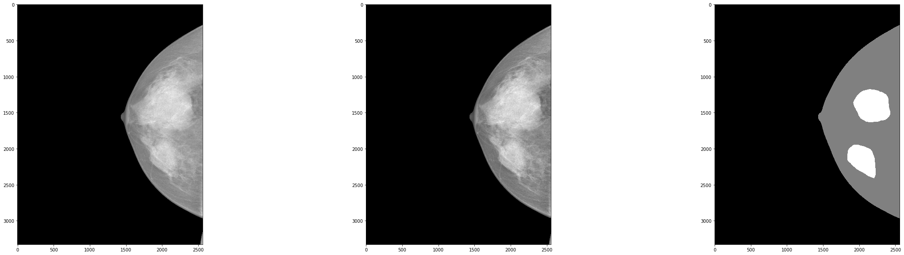
RESULTS AND ANALYSIS
And then we use Region Proposal algorithms to train Support Vector Machines and Convolutional Neural Networks for mass detection in mammograms. We use morphological enhancement to enhance the image.
MULTISCALE MORPHOLOGICAL SIFTING

Slide 43
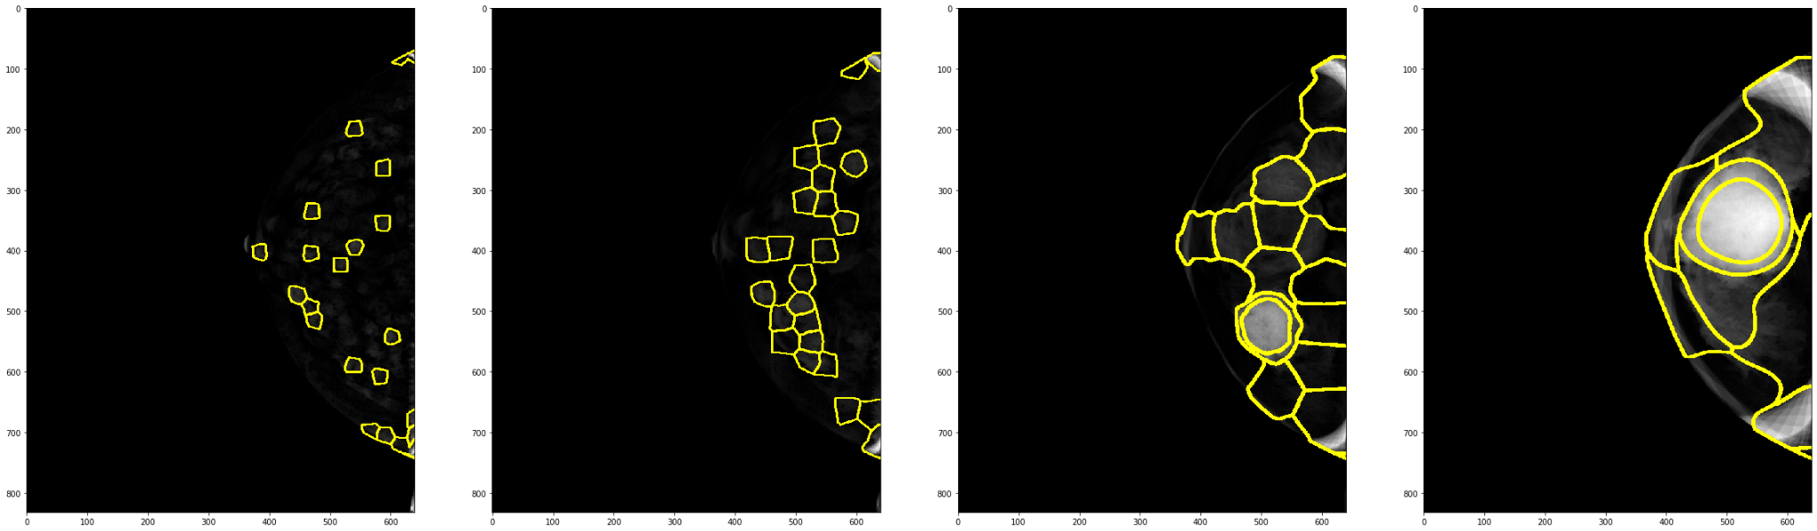
RESULTS AND ANALYSIS
After Multiscale Morphological Sifting, we perform segmentation of regions of interest.
SEGMENTATION OF ROI

Slide 44
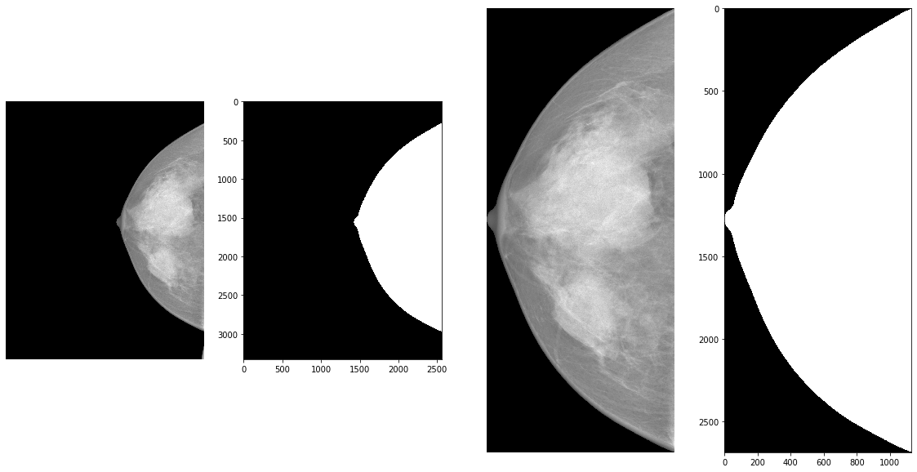
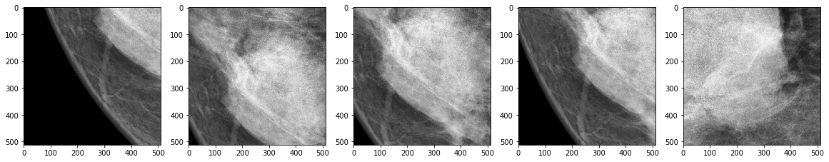
RESULTS AND ANALYSIS
Then we extract the patches using patch extraction.
PATCH EXTRACTION FINAL RESULT OF MAMMOGRAPHIC IMAGE

Slide 45
DEMO

Slide 46
THANK YOU

